Slide 1





Dyspnea in Adult:
Approach and Early Management
PIVOT Emergency Weeks Webinar
Jakarta, 20 November 2021
Irandi Putra Pratomo
Department of Pulmonology and Respiratory Medicine, Faculty of Medicine, Universitas Indonesia
COVID-19 Task Force – Pulmonology Unit, Universitas Indonesia Hospital
Indonesian Medical Education and Research Institute, Faculty of Medicine, Universitas Indonesia
Indonesian Society of Respirology
Research Institute of the Indonesian Medical Association

Slide 2










Irandi Putra Pratomo
dr., Ph.D., Sp.P(K), FAPSR
M.D., Ph.D., FAPSR
Educational Background:
Consultant in Interventional Pulmonology and Emergency Respiratory Care, Indonesian College of Pulmonology and Respiratory Medicine (2020)
Pulmonologist, FKUI (2018)
Ph.D, Hiroshima University Japan (2017)
M.D., FKUI (2008)
SCOPUS: 57192904477
SINTA: 6664786
GARUDA: 346519
Positions:
Chief of the Staff of Pulmonology Unit, Univ Indonesia Hosp Depok/RSUI (2021 - present)
LARS DHP Assessor for the National Hospital Standard (2021 - present)
Chief of COVID-19 Task Force, RSUI (2020 - present)
Pulmonologist (Sp.P): Mayapada Hospital Kuningan (2020 - present), RSUI (2019 - present), RSUD Tarakan Jakarta (2019 - present)
Faculty member, Department of Pulmonology and Respiratory Medicine, Faculty of Medicine Universitas Indonesia/FKUI (2019 - present)
Researcher member, IMERI FKUI (2017 – present)
Academics:
Co-supervisors:
Doctoral program, FKUI: 1 graduate
Residency program, FKUI: 2 students
Postgraduate program, Universitas IPB: 1 student
On-going Projects:
      Collaborative COVID-19 studies
      Collaborative social media-related health studies
      Indoor Air Pollution, FKUI – Indonesian Ministry of Public Works and Housing– Hiroshima University, Japan
Interests: pulmonology and respiratory medicine, website, big data, artificial intelligence, genomics

Slide 3




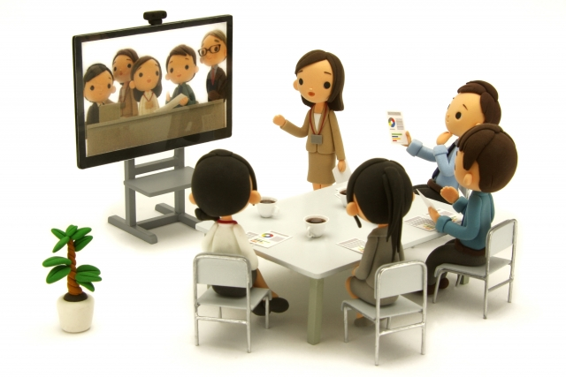
Presentation Outline
Case Illustrations
What is Dyspnea?
Why Dyspnea Happens?
Who May Develop Dyspnea?
How to Diagnose Dyspnea?
How to Manage Dyspnea?
Take Home Messages

Slide 4
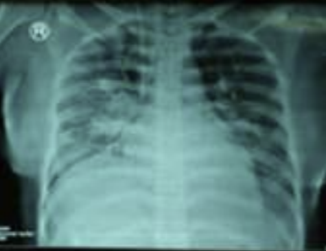
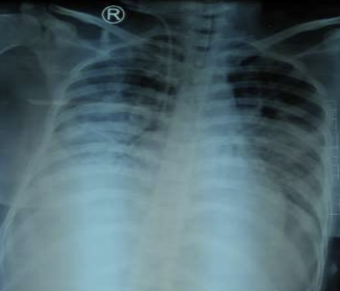
Case Illustration (1)
Female, 40 years old, came to the emergency ward with a shortness of breath since yesterday. Fever and productive cough was also present for 3 days prior. No prior history of tuberculosis or asthma. Patient was diabetic for the past 3 years and was receiving antihyperglycemic drugs and insulin.
Phys exam showed a delirious state, BP 150/80, P 110, T 38, RR 34, SpO₂ 90%. Bilateral rhonchi could be heard. Lab examination showed WBC 15,400/μL, neutrophil 84.9%, blood glucose 323 mg/dL, acetone (+), sodium 129 mEq/L, BGA were pH 7.24 pCO₂ 22.5 pO₂ 97.6 HCO₃ 9.7 BE -17.90 SaO₂ 96.5.
What are the problems of this patient?
What caused these conditions?
How to manage these conditions?
https://doi.org/10.36497/jri.v38i1.140

Slide 5
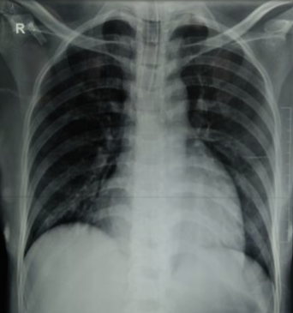
Case Illustration (2)
Female, 34 years old, came to the emergency ward with a shortness of breath since an hour ago. Pt was 34 weeks pregnant and was expecting her 4th child. Her water was breaking 2 hours ago. No prior history of hypertension.
Phys exam showed BP 160/110, P 130, T 36.5, RR 40, SpO₂ 93%. Bilateral rhonchi could be heard. Bilateral leg swelling was observed. Lab examination showed Hb 8.2 g/dL, WBC 11,810/μL, neutrophil 60.8%, albumin 2.80 g/dL, BGA were pH 7.396 pCO₂ 23.3 pO₂ 60.9 HCO₃ 14.4 BE -10.6 SaO₂ 91.5.
What are the problems of this patient?
What caused these conditions?
How to manage these conditions?
https://doi.org/10.36497/jri.v37i4.88

Slide 6
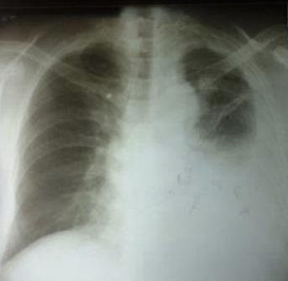
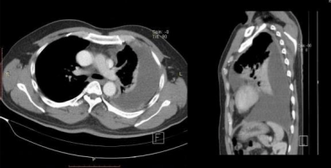
Case Illustration (3)
Male, 50 years old, came to the clinic with a shortness of breath since last month. Symptom was worsening during activity. For about a week, he experienced productive cough, loss of appetite, and weight loss. No prior history of tuberculosis or asthma. He was a non-smoker. He lived in a house which roofs are made from asbestos.
Phys exam showed BP 120/70, P 100, T 36.5, RR 26. Asymmetrical chest movement, dull percussion, and diminished lung sound was found at the left thoracic side.
What are the problems of this patient?
What caused these conditions?
How to manage these conditions?
http://dx.doi.org/10.20473/jr.v6-I.2.2020.40-44

Slide 7

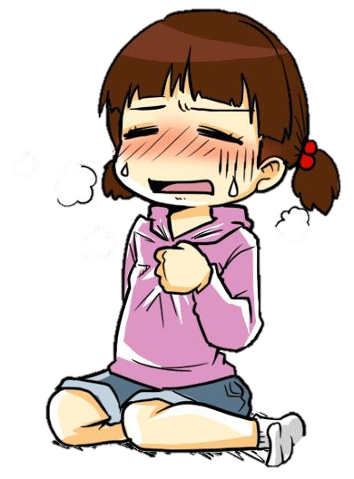
Environmental
Psychological
What is Dyspnea?
Physiological
Social
Subjective sensation/experience of uncomfortable breathing, comprised of various sensations of varying intensity
Secondary physiological
Behavioral
©NAVER
https://doi.org/10.1164/rccm.201111-2042ST
https://doi.org/10.1183/09031936.00092613
https://www.ncbi.nlm.nih.gov/books/NBK499965/
https://wordart.com/

Slide 8
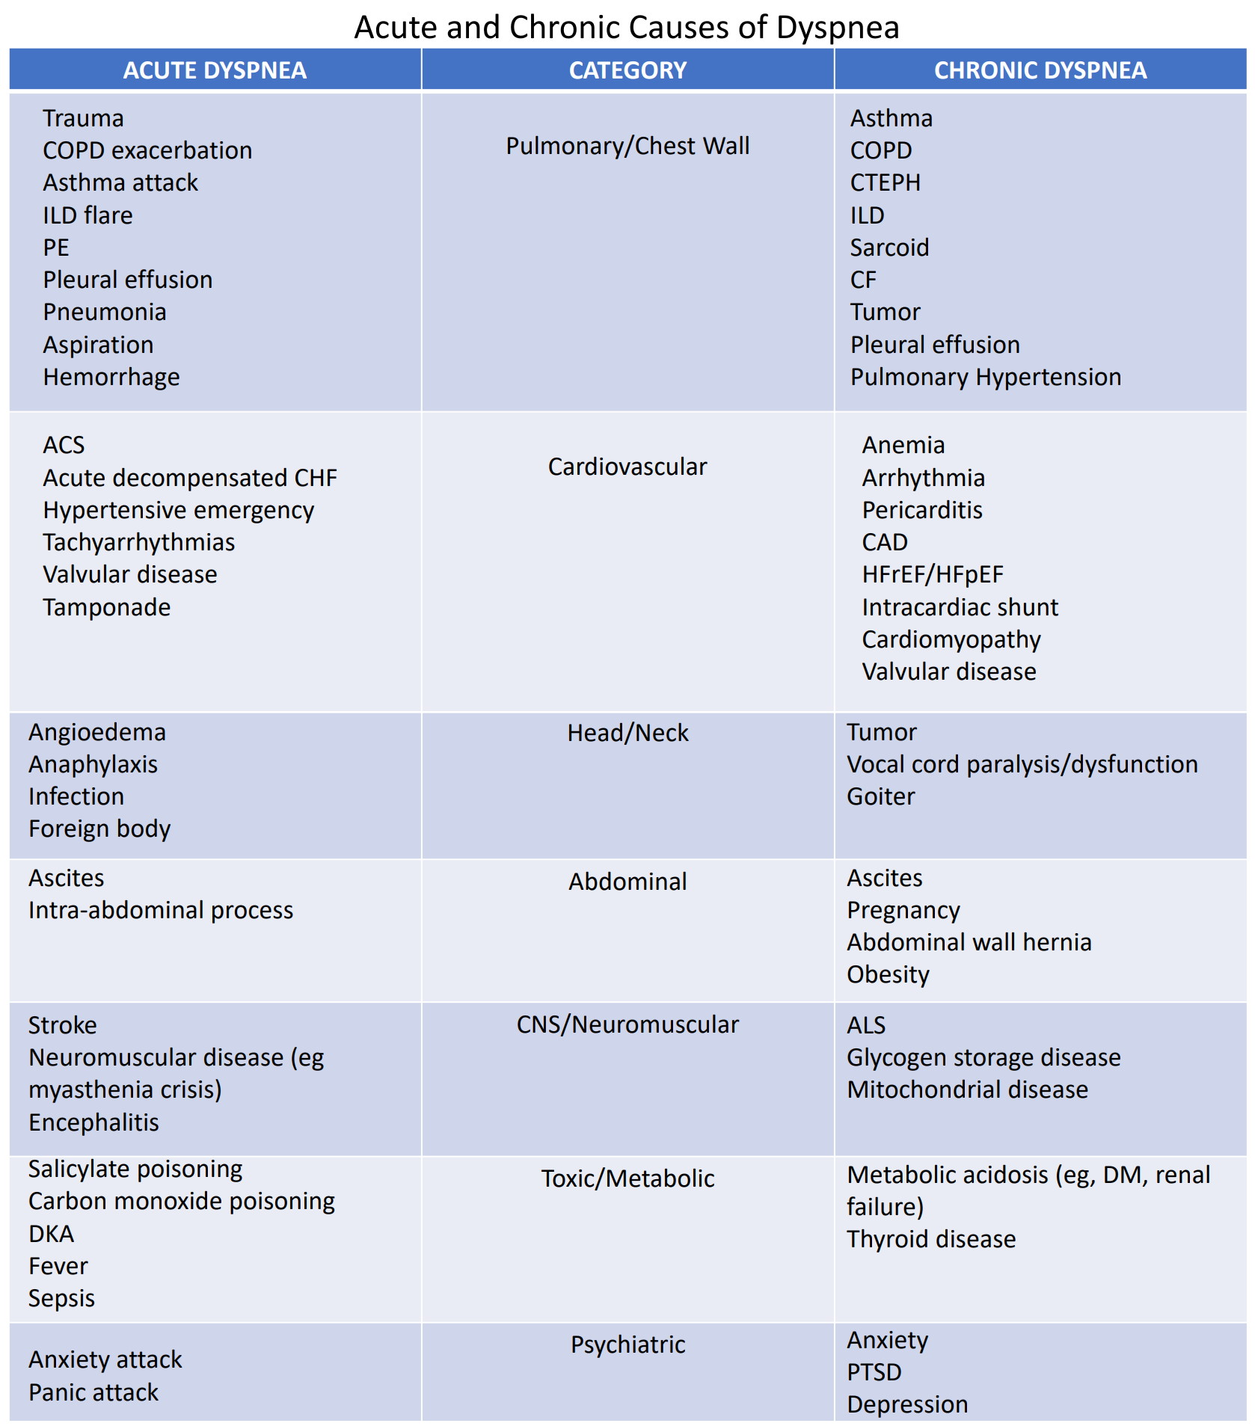
What is Dyspnea?
Acute: occurring over hours to days; usually less than 4 weeks
Chronic: occurring for more than 4 weeks
https://www.grepmed.com/images/12189/acute-causes-differential-diagnosis-dyspnea
https://www.ncbi.nlm.nih.gov/books/NBK499965/

Slide 9
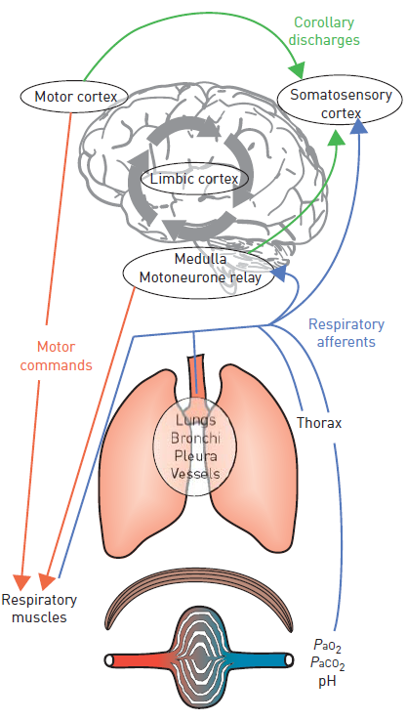
Why Dyspnea Happens?
2
1
1. Receptors triggered by stimuli:
Chemoreceptors:
hypercapnia, hypoxia, acid-base disturbance
Mechanoreceptors:
lungs, bronchi, pleura, vessels, thoracic wall, muscles
Followed afferent feedback from medulla & motor cortex to the respiratory muscles
1
1
1
1
2. Mismatch of limbic corollary discharge & afferent feedback
to the somatosensory cortex, resulted in sensation of dyspnea
https://www.ncbi.nlm.nih.gov/books/NBK499965/
https://dx.doi.org/10.1183/09031936.00092613

Slide 10
Who May Develop Dyspnea?
In the Emergency Wards
United States: 3.4 mil visits (2.4%) of >65 years old with signs of respiratory distress (e.g., RR >25, SpO2 <93%) → final diagnoses were: heart failure, pneumonia, COPD, pulmonary embolism, asthma
Boston, MA (n=67,362): dyspnea 24-hrs emergency wards visit prevalence 23%, with severe dyspnea (Borg ≥4) 4% → respiratory origin (43%), cardiac origin (25%)
AANZDEM study (n=60,059): dyspnea prevalence 5.3%, resulting in inpatient ward admission 64% and ICU admission 3.3% → causes were: respiratory infection (20.2%), heart failure (14.9%), COPD (13.6%), asthma (12.7%)
https://www.uptodate.com/contents/evaluation-of-the-adult-with-dyspnea-in-the-emergency-department
https://doi.org/10.1016/j.jpainsymman.2018.02.013
https://doi.org/10.1111/acem.13118

Slide 11
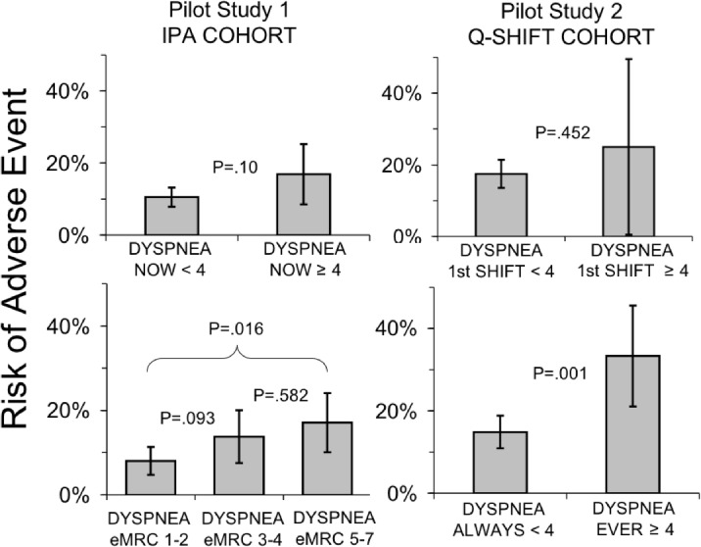
Who May Develop Dyspnea?
In the Inpatient Wards
Boston, MA: Severe dyspnea during emergency admission 13% (77/581), prevalence of severe dyspnea in inward 16% (57/367)
Severe dyspnea & unfavorable outcome: CHF, PH, COPD, Renal failure
https://doi.org/10.1371/journal.pone.0152601

Slide 12
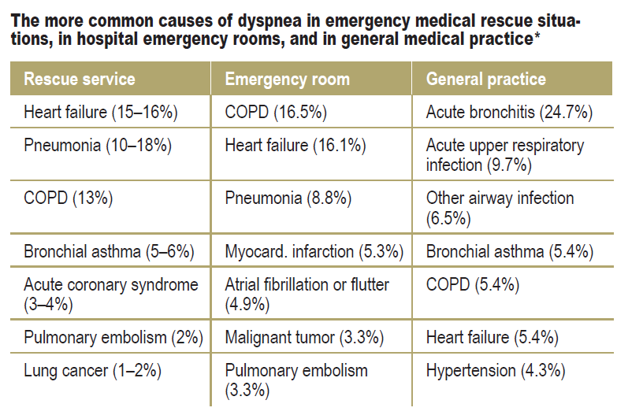
Who May Develop Dyspnea?
https://doi.org/10.3238/arztebl.2016.0834

Slide 13
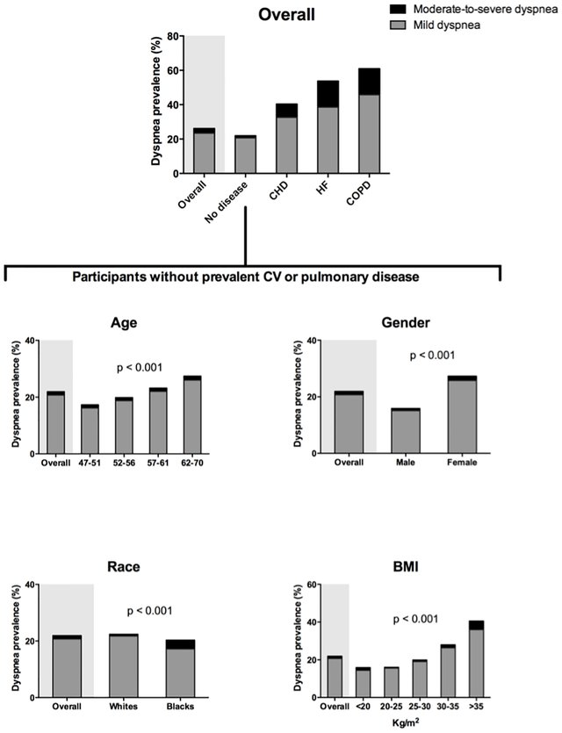
Who May Develop Dyspnea?
https://dx.doi.org/10.1093/ageing/afu001
http://dx.doi.org/10.1371/journal.pone.0165111

Slide 14
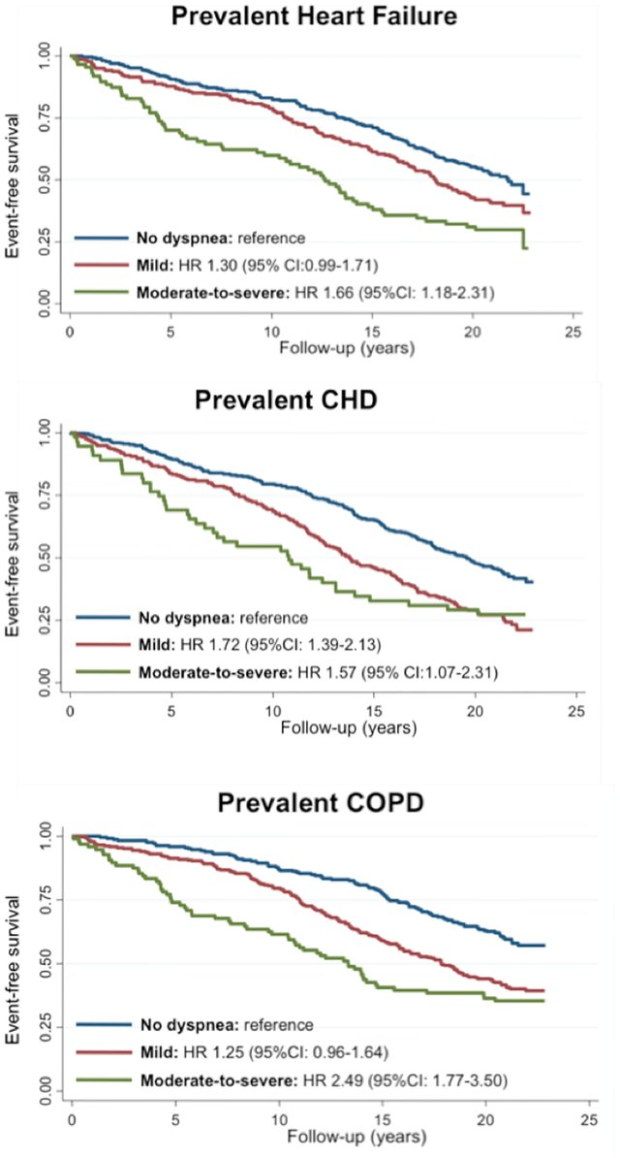
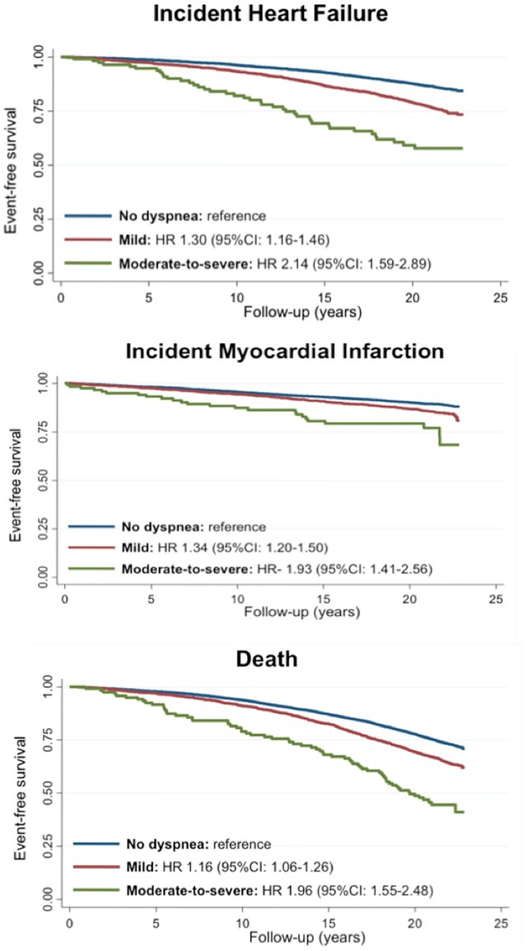
Who May Develop Dyspnea?
http://dx.doi.org/10.1371/journal.pone.0165111

Slide 15
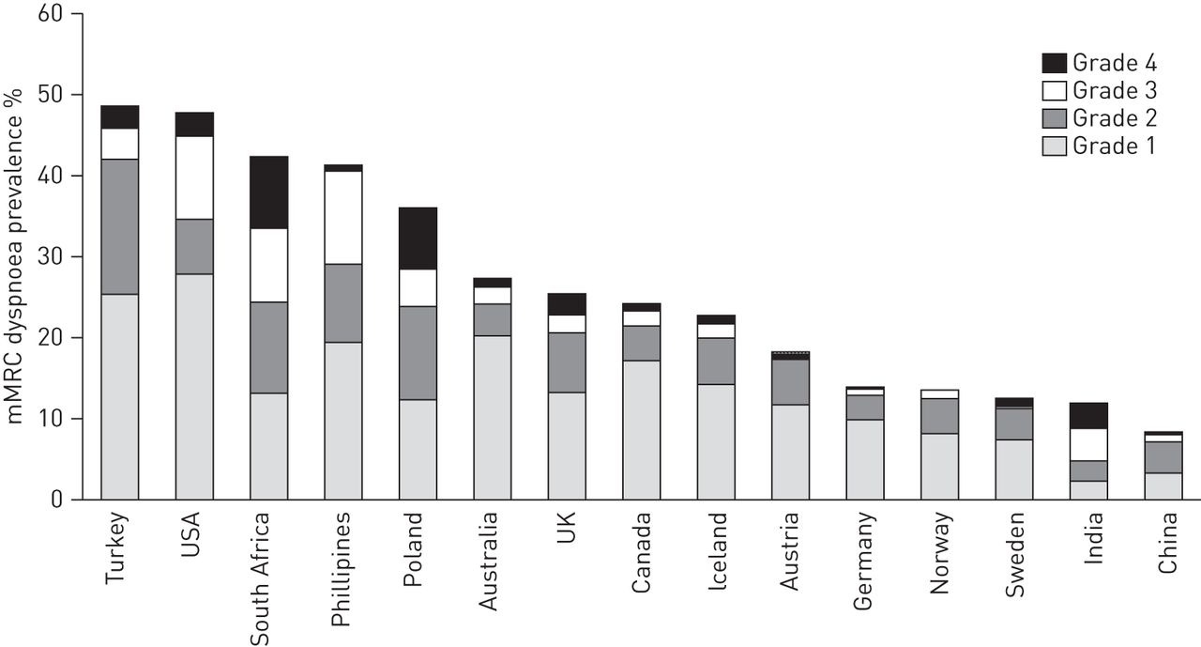
Who May Develop Dyspnea?
Global Asthma Age Groups by Gender
Dyspnea by Countries with High Burden of Chronic Resp Diseases
https://dx.doi.org/10.1183/09031936.00036813
https://ginasthma.org/wp-content/uploads/2021/05/GINA-Main-Report-2021-V2-WMS.pdf

Slide 16
Who May Develop Dyspnea?
Respiratory Origin
Asthma
etc
Cardiac Origin
Congestive Heart Failure
Neuromuscular Origin
Chest trauma with fracture or flail chest
Systemic Illness
COPD
Pneumonia
Pulmonary Embolism
Thoracic Malignancy
Pneumothorax
Aspiration
Pleural Disease
Pulmonary Edema
Acute Coronary Syndrome
Pericardial Tamponade
Valvular Heart Disease
Pulmonary Hypertension
Cardiac Arrhythmia
Intracardiac Shunting
Massive Obesity
Kyphoscoliosis
Central nervous system or spinal cord dysfunction
Phrenic nerve paralysis
Myopathy
Neuropathy
Psychogenic Origin
Hyperventilation syndrome
Psychogenic dyspnea
Vocal cord dysfunction syndrome
Foreign body aspiration
Anemia
Acute renal failure
Metabolic acidosis
Thyrotoxicosis
Cirrhosis of the liver
Anaphylaxis
Sepsis
etc
https://www.ncbi.nlm.nih.gov/books/NBK499965/

Slide 17
How to Diagnose Dyspnea?
Vital Signs
Physical Exam
Supportive Exam
History Taking
Lab Workout
RESPIRATORY IMPAIRMENT | Respiratory dysfunction clinically significant to produce discomfort
RESPIRATORY INSUFFICIENCY | Respiratory disturbance, strong enough to hamper daily certain activities, that can be measured from the mechanic of breathing and or from gas exchange
RESPIRATORY DISTRESS | Increase & worsening respiratory effort that can be seen from clinical appearance
RESPIRATORY FAILURE | Disturbance of 1 (one) aspect or more respiratory function & life threatening
https://www.ncbi.nlm.nih.gov/books/NBK499965/
https://doi.org/10.1164/rccm.201111-2042ST

Slide 18

How to Diagnose Dyspnea?
History Taking
Temporal
acute onset vs. chronic vs. acute worsening of preexisting symptoms
intermittent vs. permanent
episodic (attacks)
Pathogenetic
problems relating to the respiratory system
(central control of breathing, airways, gas exchange)
problems relating to the cardiovascular system
mixed cardiac and pulmonary causes
other causes, e.g., anemia, thyroid disease, poor physical condition (i.e., muscle deconditioning)
mental causes
Situational
at rest
on exertion
accompanying emotional stress
depending on body position
depending on special exposure(s)
https://doi.org/10.3238/arztebl.2016.0834

Slide 19
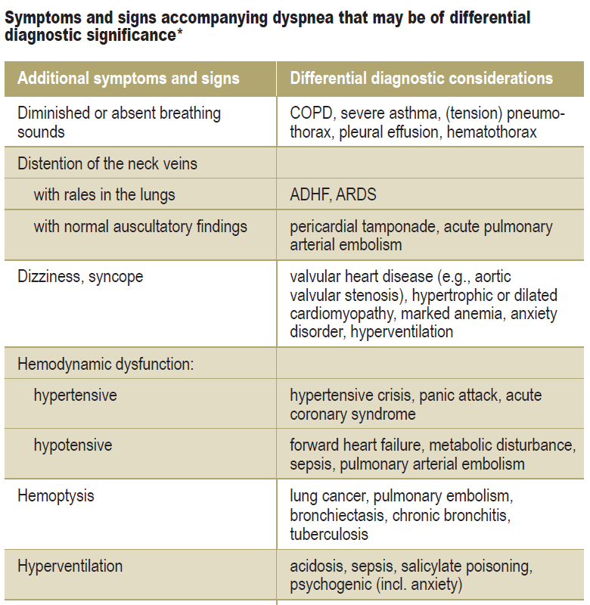
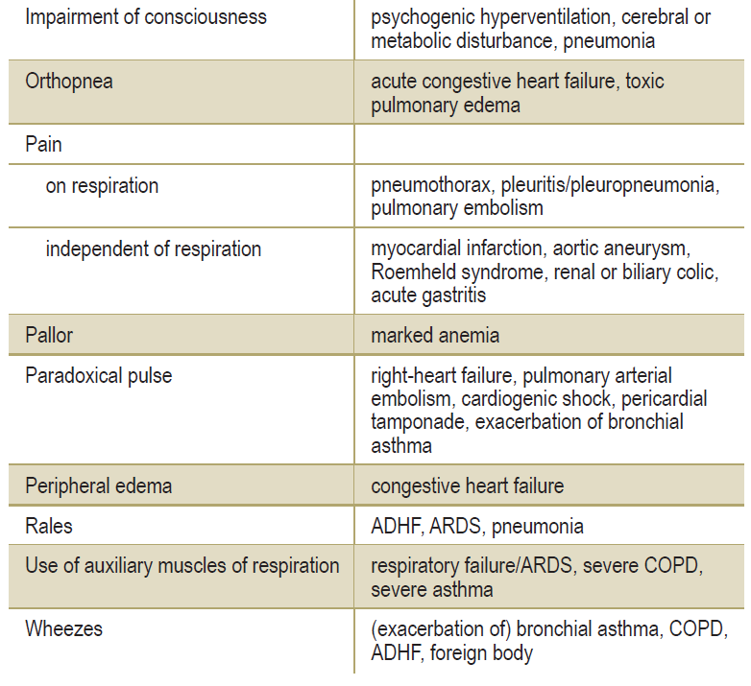
How to Diagnose Dyspnea?
https://doi.org/10.3238/arztebl.2016.0834

Slide 20
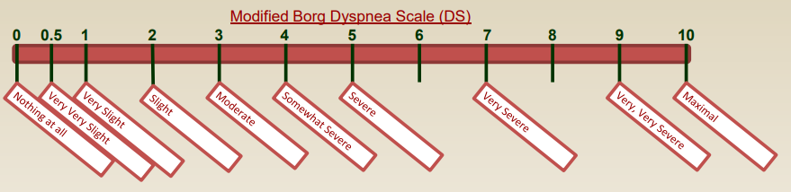
How to Diagnose Dyspnea?
Borg CR10/Modified Borg Scale (MBS) → widely used to “quantify” dyspnea objectively
Most definition of severe dyspnea: Borg ≥4
Others: American Thoracic Society Scale, St George Respiratory Questionnaire (SGRQ), Visual Analogue Scale for dyspnea
https://doi.org/10.1183/13993003.02089-2015
https://doi.org/10.1164/rccm.201111-2042ST

Slide 21
How to Diagnose Dyspnea?
Respiratory Distress
Etiologies: pulmonary infection or aspiration, extra-pulmonary (sepsis, trauma, massive transfusion, drowning, drug overdose, fat embolism, inhalation of toxic fumes, pancreatitis)
Risk Factors: Advanced age, females, smoking, alcoholism, cardiovasc, traumatic brain injury
Incidence 64.2 – 78.9/100,000; mortality 43% (US)
https://www.ncbi.nlm.nih.gov/books/NBK436002/

Slide 22
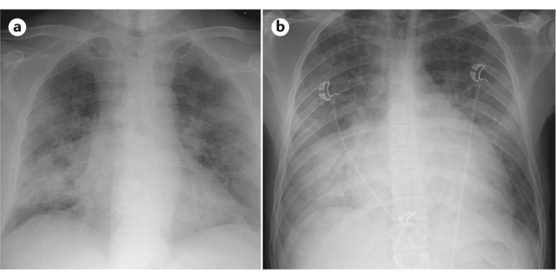
How to Diagnose Dyspnea?
Respiratory Distress
Criterions: acute, bilateral lung infiltrates on CXR of a non-cardiac origin, and a PaO₂/FiO₂ ratio of less than 300 mmHg
Common signs:
Accessory chest muscles
Pursed-lip breathing
In pain
Prominent neck & face veins
Substernal or intercostal retractions
Audible stridor, wheezing or rhonchi
RR: 25-29 x/min → mortality rate (21%), predictor of cardiac arrest
https://doi.org/10.1038/s41572-019-0069-0
https://www.ncbi.nlm.nih.gov/books/NBK436002/

Slide 23
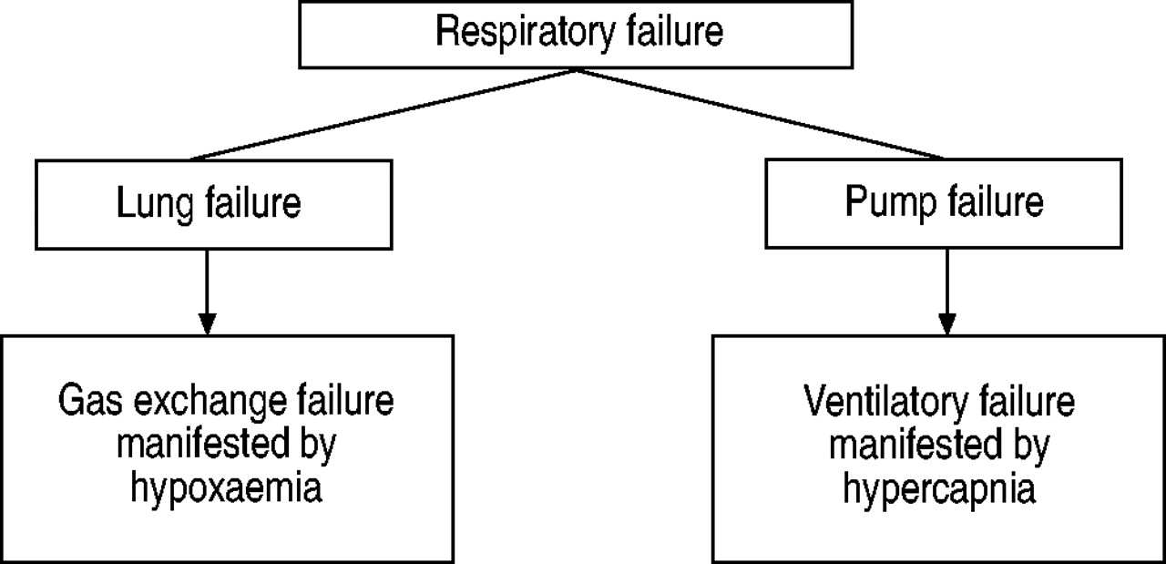
How to Diagnose Dyspnea?
Type 1 (hypoxemic) → PaO₂ <60 mmHg with normal or subnormal PaCO₂
Type 2 (hypercapnic) → PaCO₂ >50 mmHg commonly accompanied with hypoxemia
https://doi.org/10.1183/09031936.03.00038503
https://www.ncbi.nlm.nih.gov/books/NBK526127/

Slide 24
How to Diagnose Dyspnea?
Symptoms and signs of hypoxemia
Dyspnea, irritability
Confusion, somnolence
Tachycardia, arrhythmia
Tachypnea
Cyanosis
Symptoms and signs of hypercapnia
Headache
Change of behavior
Coma
Tremor
Papilloedema
Warm extremities
https://doi.org/10.1183/09031936.03.00038503
https://www.ncbi.nlm.nih.gov/books/NBK526127/

Slide 25
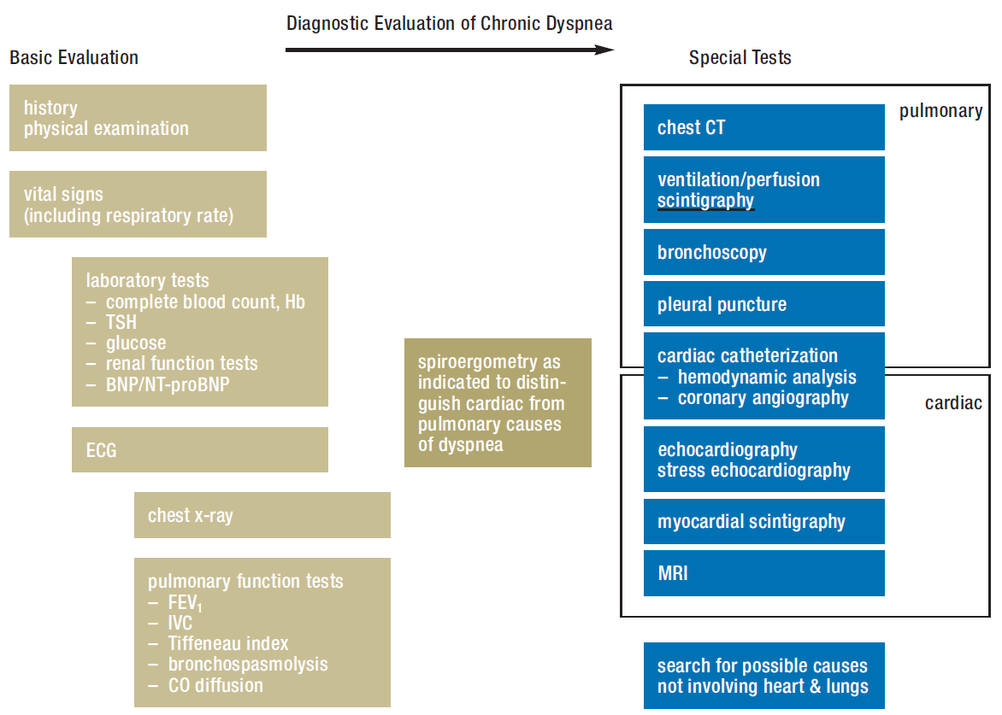
How to Diagnose Dyspnea?
https://doi.org/10.3238/arztebl.2016.0834
https://www.ncbi.nlm.nih.gov/books/NBK526127/

Slide 26
How to Diagnose Dyspnea?
Chronic Terminal Dyspnea
“Sustained & severe resting breathing discomfort in patients with advanced, life-limiting illness and overwhelms the patient and caregiver’s ability to achieve symptom relief”
Often of irreversible etiology (ILD, COPD, cancer), can occur suddenly
Interacting factors: worsening of dyspnea experience,
a heightened psycho-social-spiritual patient response, and a setting by unprepared caregivers who are too overwhelmed to respond in the optimal manner
Underlying disease | Prevalence
Lung cancer | 46 – 70%
COPD | 56%
CHF | 51 – 61%
https://doi.org/10.1513/AnnalsATS.201306-169ST
https://doi.org/10.1016/j.ccc.2004.03.015

Slide 27
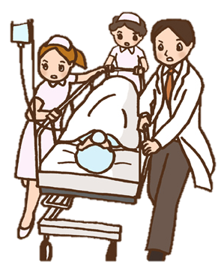
How to Manage Dyspnea?
Identify & treat
life-threating condition
Vital Signs
History Taking
Investigate underlying disease, risk factor, etiologies, identify impairments
Physical Exam
Lab Workout
Supportive Exam
Administer O₂, respiratory & airway support, cardiovascular & circulatory support, rehabilitation support, treat underlying disease
Treatment
https://www.ncbi.nlm.nih.gov/books/NBK499965/
https://doi.org/10.1164/rccm.201111-2042ST

Slide 28
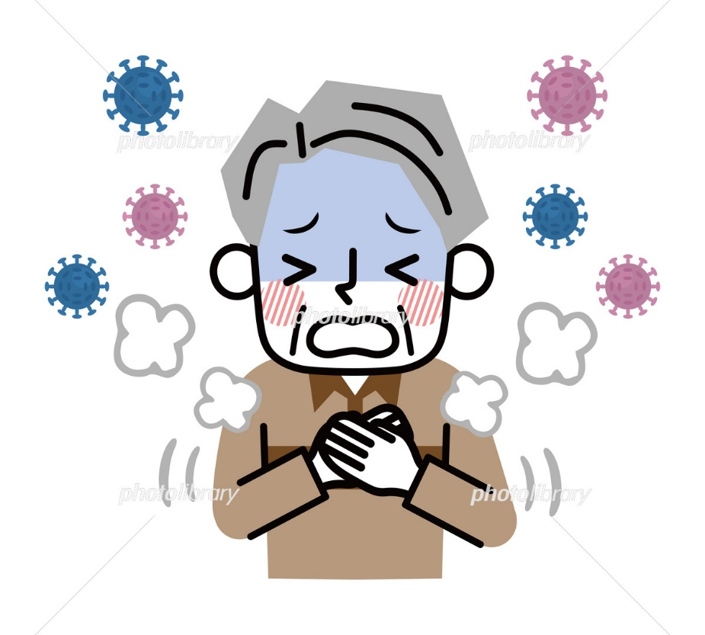
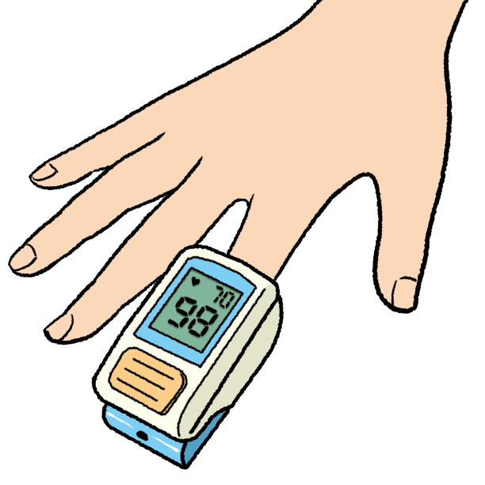
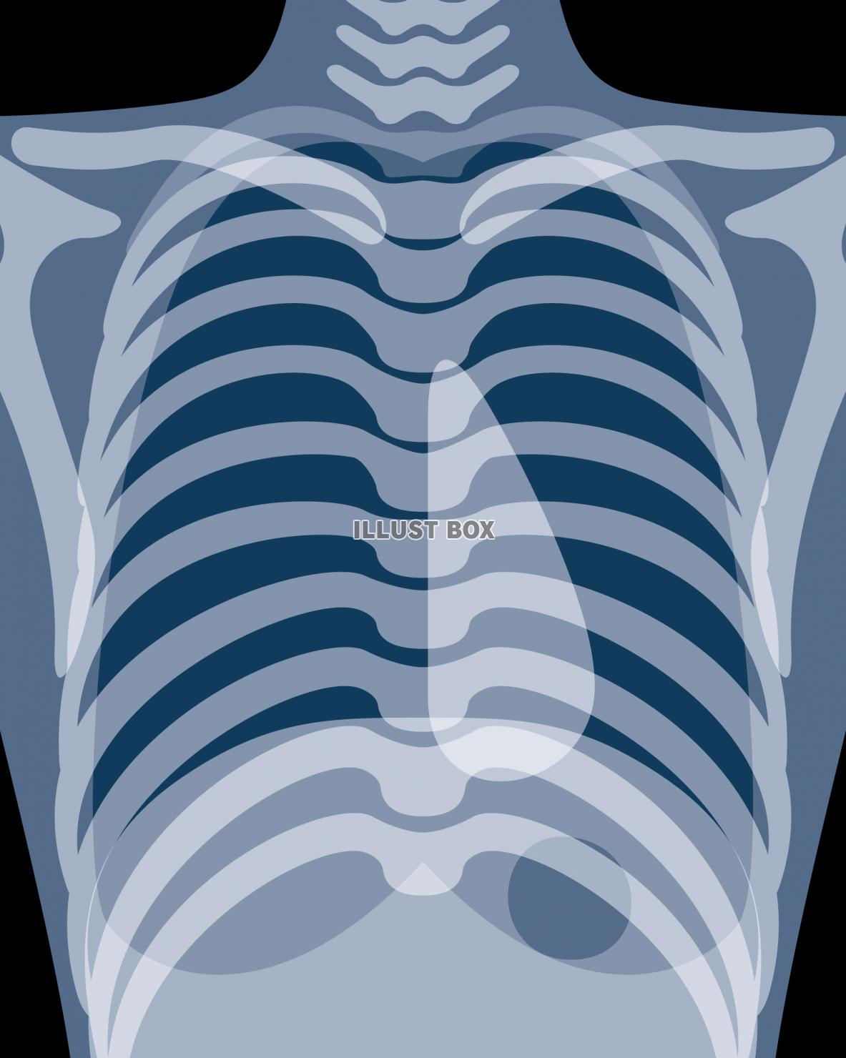
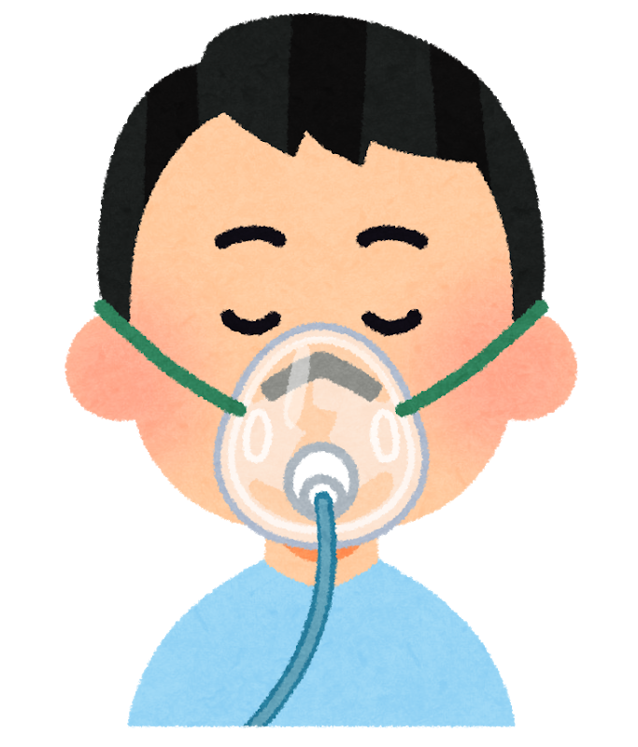
Oxygen Therapy
How to Manage Dyspnea?
Determine an Increased Oxygen Demand in → Clinical signs of hypoxemia:
    Increased work of breathing, respiration rate
    Decreased SpO₂
    Abnormal CXR (i.e. pneumonia, effusion, etc)
Estimate Oxygen Demand & Treat:
    Take blood gas analysis (BGA)
    Calculate A-a DO₂
    Calculate required FiO₂
    Oxygen supplementation
https://dx.doi.org/10.4103%2F0970-2113.197116
https://www.ncbi.nlm.nih.gov/books/NBK482316/

Slide 29
A-a DO₂
How to Manage Dyspnea?
A-a DO₂ | Hypoxemic Condition Associated with A-a DO₂ | Oxygen response
Normal | Hypoventilation Drive Neuromuscular disorders Central nervous system disorder | Responsive
 | Low inspired FiO₂ (e.g. high altitude, inadequate oxygen)
Increased | Dead space Pulmonary embolism Atelectasis Pneumonia Obstructive lung disease (e.g. Asthma, COPD) Pneumothorax
 | Altered diffusion/blood-gas barrier Interstitial lung disease, incl pulmonary fibrosis
 | Shunt Congestive heart failure Lobar/diffuse pneumonia Adult Respiratory Distress Syndrome (ARDS) | Unresponsive
In normal young adult,
A-a DO₂ < 10 mmHg
Increases with age:
  Age 20: 4 to 17 mmHg
  Age 40: 10 to 24 mmHg
  Age 60: 17 to 31 mmHg
  Age 80: 25 to 38 mmHg
https://dx.doi.org/10.4103%2F0970-2113.197116
https://www.ncbi.nlm.nih.gov/books/NBK482316/

Slide 30
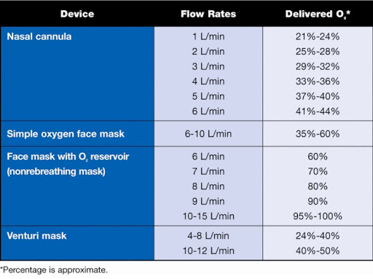
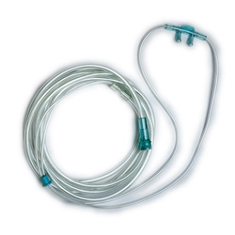
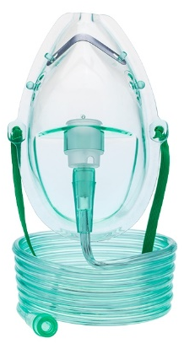
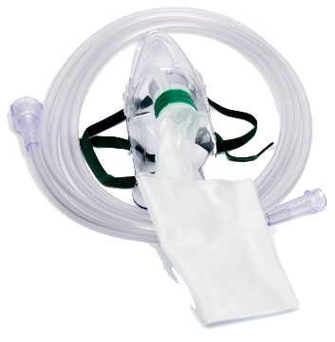
PaO₂:FiO₂
How to Manage Dyspnea?
Identify current FiO₂
Obtain PaO₂ from BGA
Calculate PaO₂:FiO₂
target >300
Re-adjust FiO₂ → re-adjust device & flow rates
Keep in mind:
Patient’s Comfort
*Room air, FiO₂ = 21%
https://dx.doi.org/10.4103%2F0970-2113.197116
https://www.ncbi.nlm.nih.gov/books/NBK482316/

Slide 31
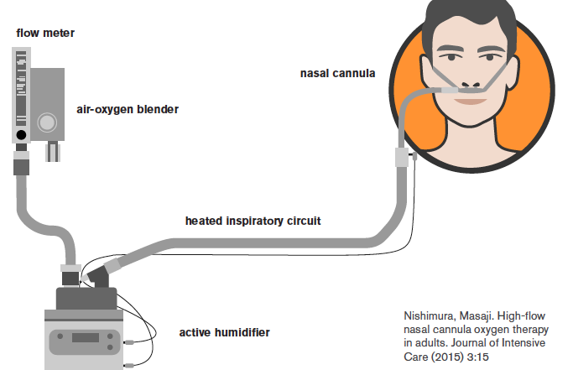
High-flow Oxygen Therapy
How to Manage Dyspnea?
Advanced oxygen therapy
Provide heated & humidified oxygen at flow 15-60 L/min
Terminology:
  High-flow nasal cannula (HFNC)
  High-flow oxygen therapy
  Nasal high-flow
  Trans-nasal insufflation
  Kanal hidung arus cepat (KHAC)
  (By respective existing brand)
https://dx.doi.org/10.4103%2F0970-2113.197116
https://www.ncbi.nlm.nih.gov/books/NBK482316/

Slide 32
https://doi.org/10.4103/smj.smj_64_20

Slide 33
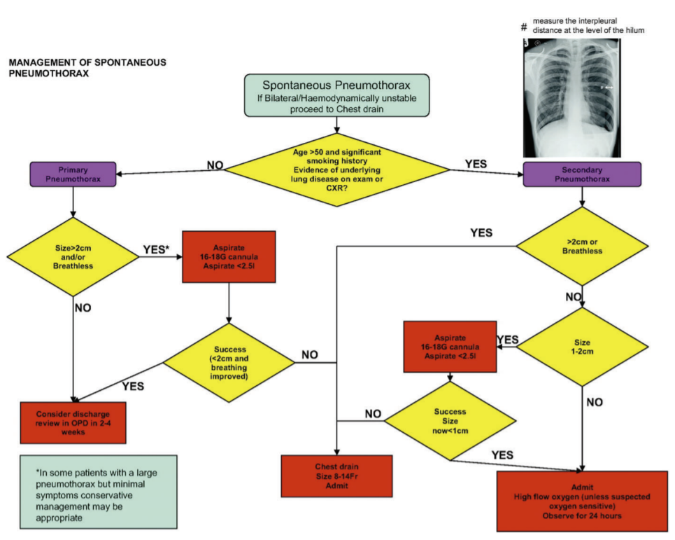
https://doi.org/10.1111/ans.14713

Slide 34
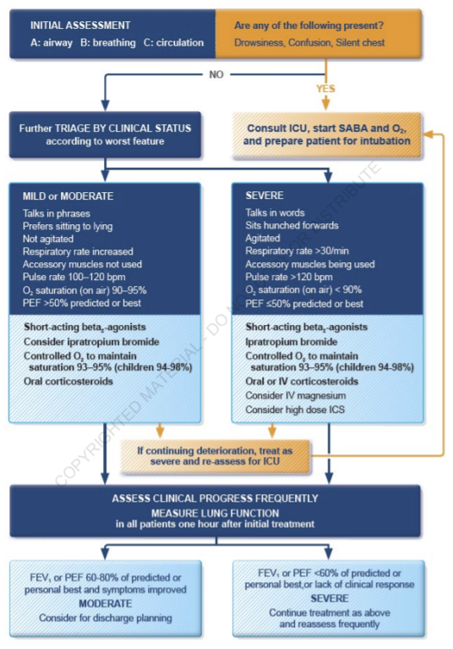
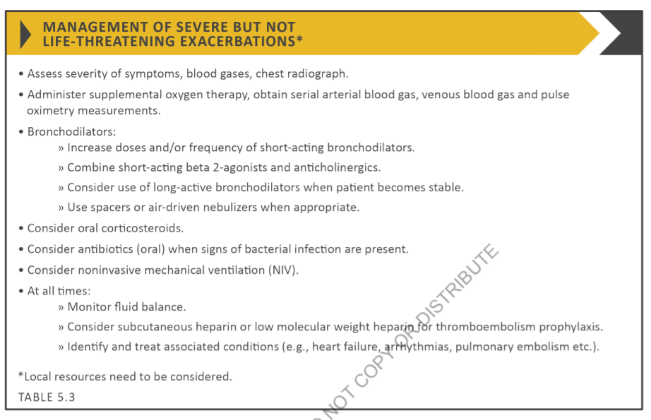
Acute asthma
Acute COPD
https://ginasthma.org/wp-content/uploads/2021/05/GINA-Main-Report-2021-V2-WMS.pdf
https://goldcopd.org/wp-content/uploads/2020/11/GOLD-REPORT-2021-v1.1-25Nov20_WMV.pdf

Slide 35

Take Home Messages
Acute, chronic, or an acute episode of dyspnea may be caused by diseases of lung, cardiac, systemic, or psychological (or combined) origins
Prompt & precise diagnostic from history taking & physical examinations is mandatory → screen for life-threatening dyspnea
Initial treatment include oxygen therapy & treating the underlying life-threatening condition

Slide 36



Thank You for Your Attention
#StayatHome
https://spesialis-paru.id/

